Slide 1
CSE 412 Databases Berkan AKIN 171044073
FInal Project

Slide 2
DataBases tables And RelatIons
In this project we have 14 table. Tables are fallows
İnvoicedetail
İtem
Order
Orderdetail
Payment
Town
Address
user_
Basket
Basketdetail
City
Country
District
İnvoice

Slide 3
DataBases tables And RelatIons
Relations
Between these tables we have following relations;
• 5 one to one relation ( Basket BasketDetails)
• 8 one to many relation ( User Adress)
• 3 many to many relation (User Item)
Total we have 16 relations.

Slide 4
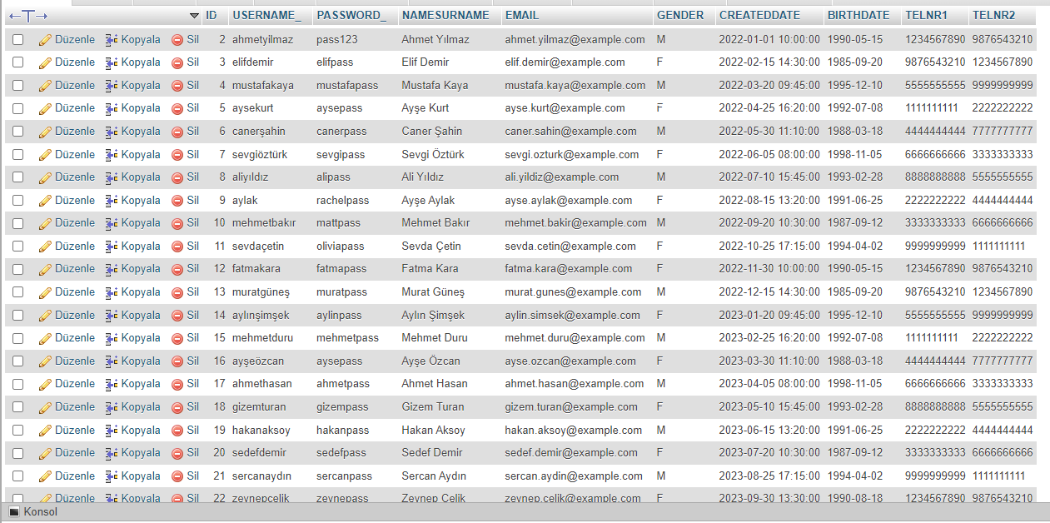
Creating Tables and Inserting Data
Tables are filled with sample 50 rows of data

Slide 5
Normalization
In this project, I have 3NF, BCNF and 4NF normalization.

Slide 6
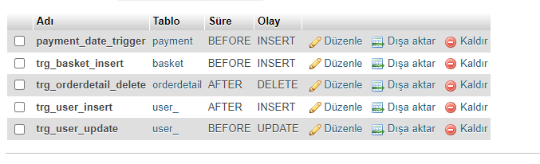
Triggers
In this project, I have 5 triggers. They are as follows.

Slide 7
JoIn QuerIes
3 different joins are used
Innner JoIn
Left Joın
Rıght JOIN

Slide 8
OTHER DetaILS

